Slide 1

Algebra 1
Unit 6, Lesson 1 Solving Linear Inequalities in One Variable Volume 1, pg. 291

Slide 2


Benchmark
MA.912.AR.2.6
Given a mathematical or real-world context, write and solve one-variable linear inequalities, including compound inequalities. Represent solutions algebraically or graphically.
volume 1, pg. 291

Slide 3
Integrated Mathematical Thinking and Reasoning Standards
MA.K12.MTR.1.1 Actively participate in effortful learning both individually and collectively.
MA.K12.MTR.2.1 Demonstrate understanding by representing problems in multiple ways.
MA.K12.MTR.3.1 Complete tasks with mathematical fluency.
MA.K12.MTR.4.1 Engage in discussions that reflect on the mathematical thinking of self and others.
MA.K12.MTR.5.1 Use patterns and structure to help understand and connect mathematical concepts.
MA.K12.MTR.6.1 Assess the reasonableness of solutions.
MA.K12.MTR.7.1 Apply mathematics to real-world contexts.
volume 1, pg. 291

Slide 4

Learning Targets
I can solve two-step or multi-step one-variable inequalities.
I can graph the solution of an inequality on a number line.
I can interpret solutions to problems as viable or non-viable options.
volume 1, pg. 291

Slide 5

Warm-Up
volume 1, pg. 291

Slide 6
6.1.1 Warm-Up: Planetary Research Scientist
Margarita Marinova is a planetary research scientist who studies Earth, as well as other planets. Margarita says the biggest key to success is to be passionate about something. She shares that while in high school, she got laughed at because she wanted to study Mars. Instead of reacting negatively to her peers, she founded the Toronto Chapter of the International Mars Society. Throughout her career, her passion for Mars has led her to spearheading many projects that focus on understanding Mars.
Why do you think it is important for people to be encouraged, rather than discouraged, about their passions?
volume 1, pg. 291

Slide 7
Margarita says she loves asking the question “why?” She said one of the things that she thinks is important is being curious.
Describe something you have a passion and curiosity about that you think could lead you to a certain career.
volume 1, pg. 291

Slide 8

Refresher
volume 1, pg. 292

Slide 9

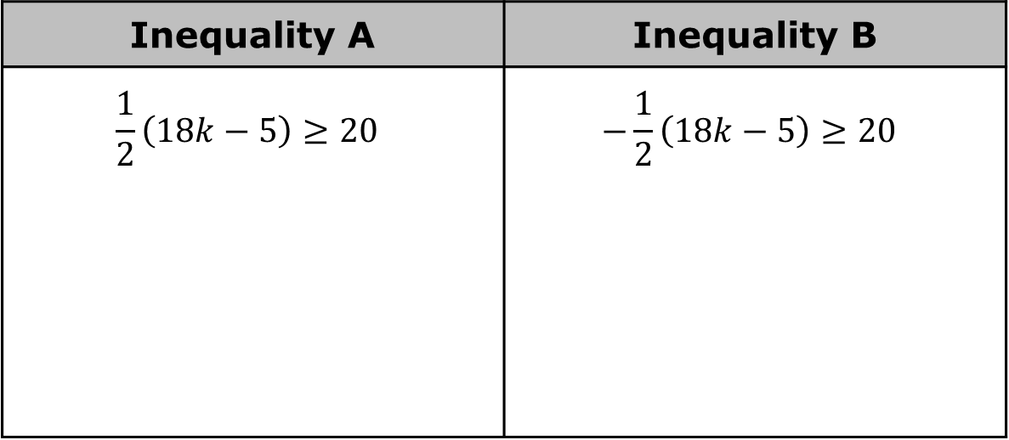
6.1.2 Refresher: Solving & Graphing Linear Inequalities in One Variable
Two inequalities are given in the table.
Solve each inequality and then graph each solution set on the number lines provided.
Inequality A | Inequality B
$$\frac{1}{2}\left(18k−5\right)≥20$$ | $$−\frac{1}{2}\left(18k−5\right)≥20$$
volume 1, pg. 292

Slide 10
Check your work with your partner and if necessary, resolve any differences.
Compare the given inequalities, the steps in solving each inequality, and the two solutions.
Similarities | Differences
volume 1, pg. 292

Slide 11
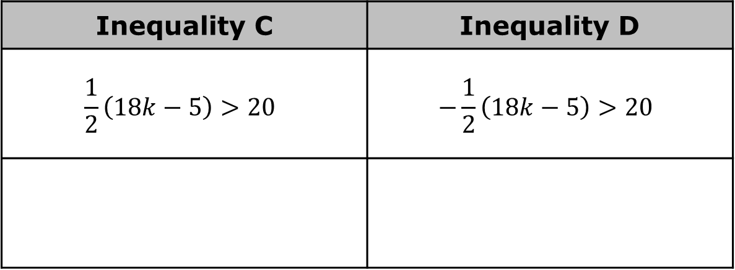
Discuss with your partner, without solving, how the graphs of each solution can be found. Then, graph the solution set on each number line.
Inequality C | Inequality D
$$\frac{1}{2}\left(18k−5\right)>20$$ | $$−\frac{1}{2}\left(18k−5\right)>20$$
volume 1, pg. 292

Slide 12

Guided Instruction
volume 1, pg. 293

Slide 13
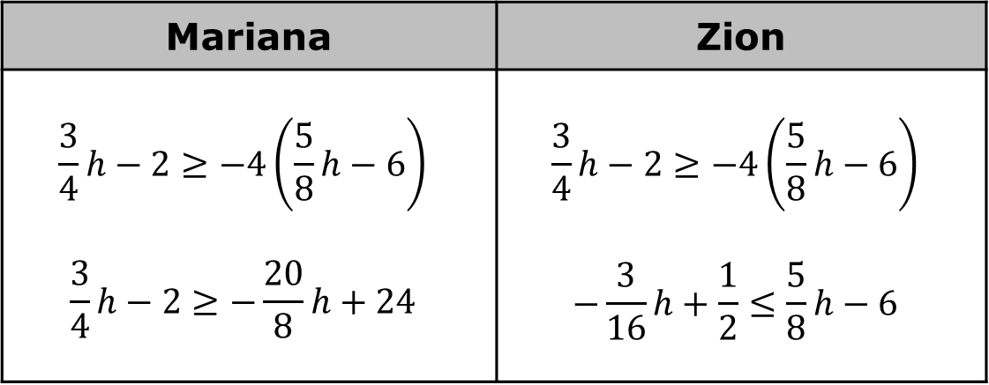
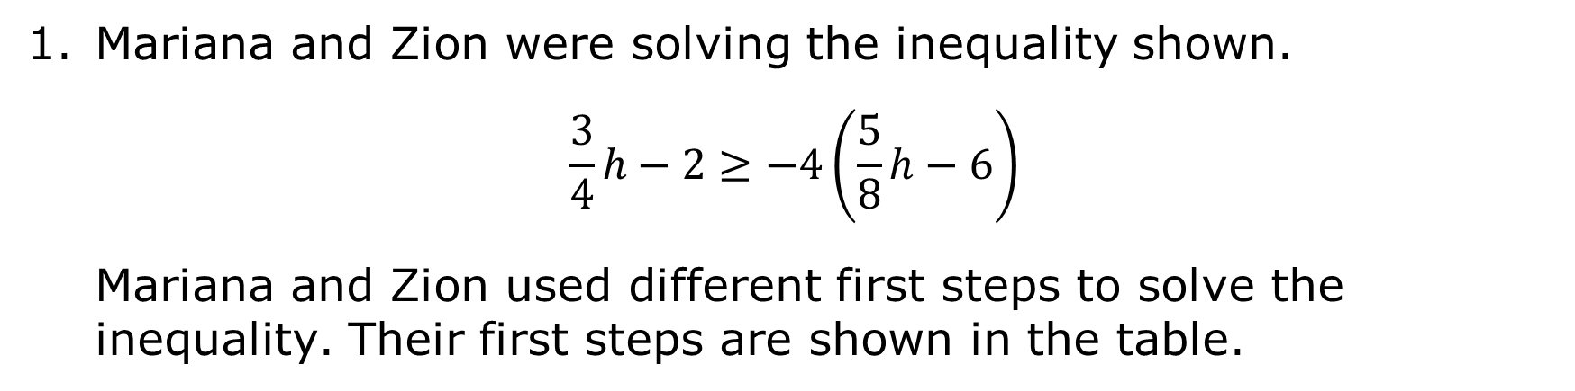
6.1.3 Guided Instruction: Multi-Step Linear Inequalities
Mariana and Zion were solving the inequality shown.
$$\frac{3}{4}h−2≥−4\left(\frac{5}{8}h−6\right)$$
Mariana and Zion used different first steps to solve the inequality. Their first steps are shown in the table.
Mariana | Zion
$$\frac{3}{4}h−2≥−4\left(\frac{5}{8}h−6\right)$$ $$\frac{3}{4}h−2≥−\frac{20}{8}h+24$$ | $$\frac{3}{4}h−2≥−4\left(\frac{5}{8}h−6\right)$$ $$−\frac{3}{16}h+\frac{1}{2}≤\frac{5}{8}h−6$$
volume 1, pg. 293

Slide 14
Explain what Mariana did in her first step.
Explain what Zion did in his first step.
Discuss with your partner whether Mariana and Zion will get the same answer based on their first steps. Summarize your discussion.
volume 1, pg. 293

Slide 15
Complete the solutions for both Mariana and Zion, continuing from their first step in the space provided in the table.
Write the solution set of the inequality in set-builder notation.
Graph the solution set of the inequality.
volume 1, pg. 293

Slide 16
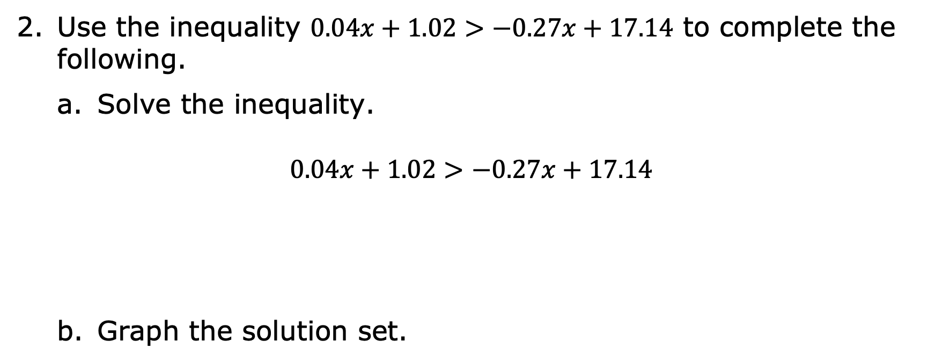
Use the inequality $0.04x+1.02>−0.27x+17.14$ to complete the following.
Solve the inequality.
$$0.04x+1.02>−0.27x+17.14$$
Graph the solution set.
volume 1, pg. 293

Slide 17
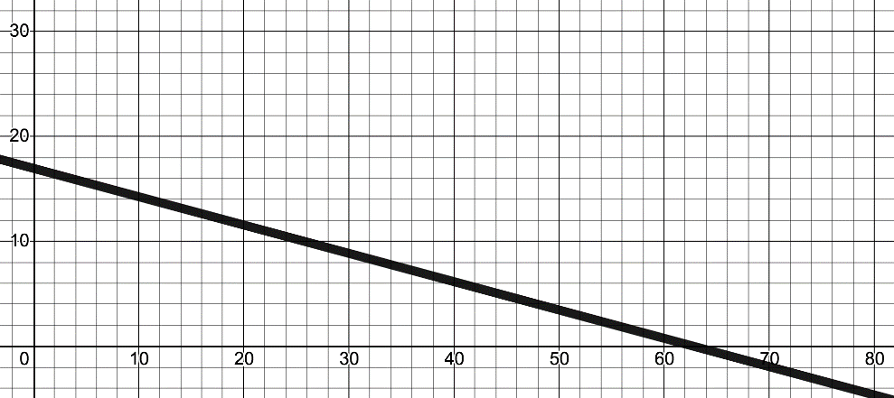

The National Center for Education Statistics has gathered data on the majors of graduating college students since 1970. The percentage of degrees in education and computer science are shown.
Education Degrees Conferred (1970-2017)
$$y=−0.27x+17.14$$
Education Degrees (% of total)
Years since 1970
volume 1, pg. 294

Slide 18
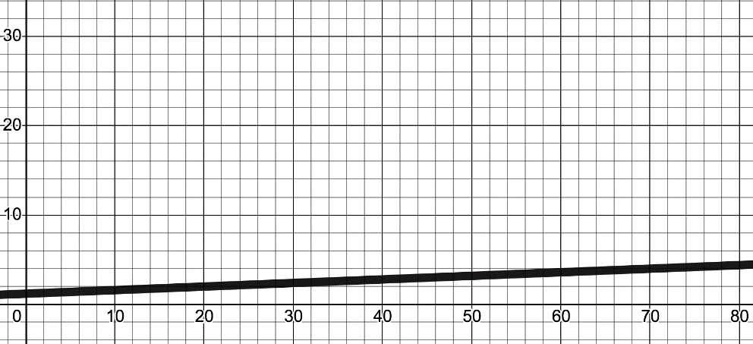

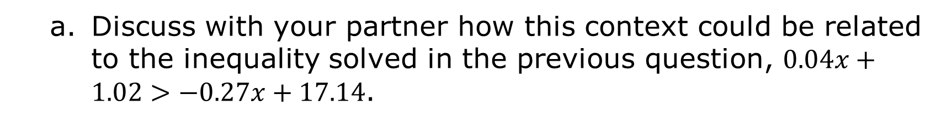
Computer Science Degrees Conferred (1970-2017)
$$y=0.04x+1.02$$
Computer Science Degrees (% of total)
Years since 1970
Discuss with your partner how this context could be related to the inequality solved in the previous question, $0.04x+1.02>−0.27x+17.14$.
volume 1, pg. 294

Slide 19
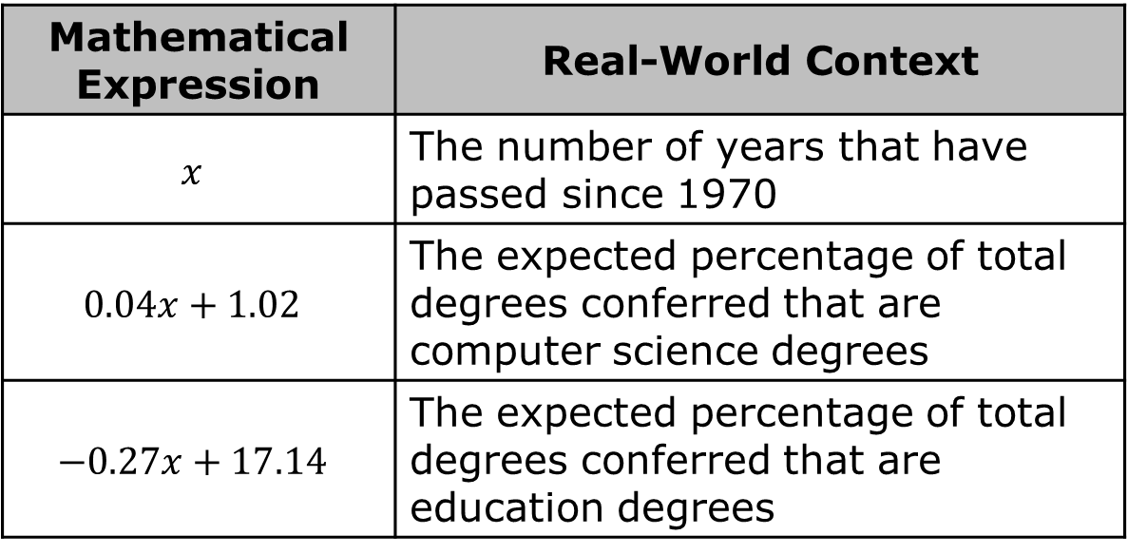
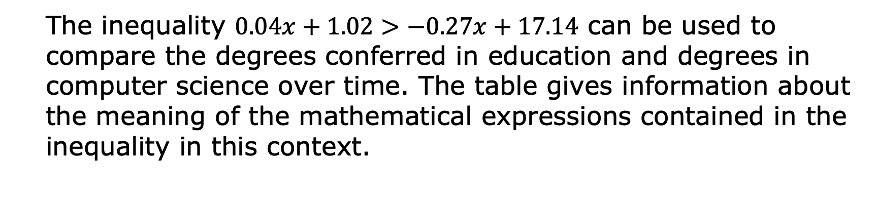
The inequality $0.04x+1.02>−0.27x+17.14$ can be used to compare the degrees conferred in education and degrees in computer science over time. The table gives information about the meaning of the mathematical expressions contained in the inequality in this context.
Mathematical Expression | Real-World Context
$$x$$ | The number of years that have passed since 1970
$$0.04x+1.02$$ | The expected percentage of total degrees conferred that are computer science degrees
$$−0.27x+17.14$$ | The expected percentage of total degrees conferred that are education degrees
volume 1, pg. 294

Slide 20
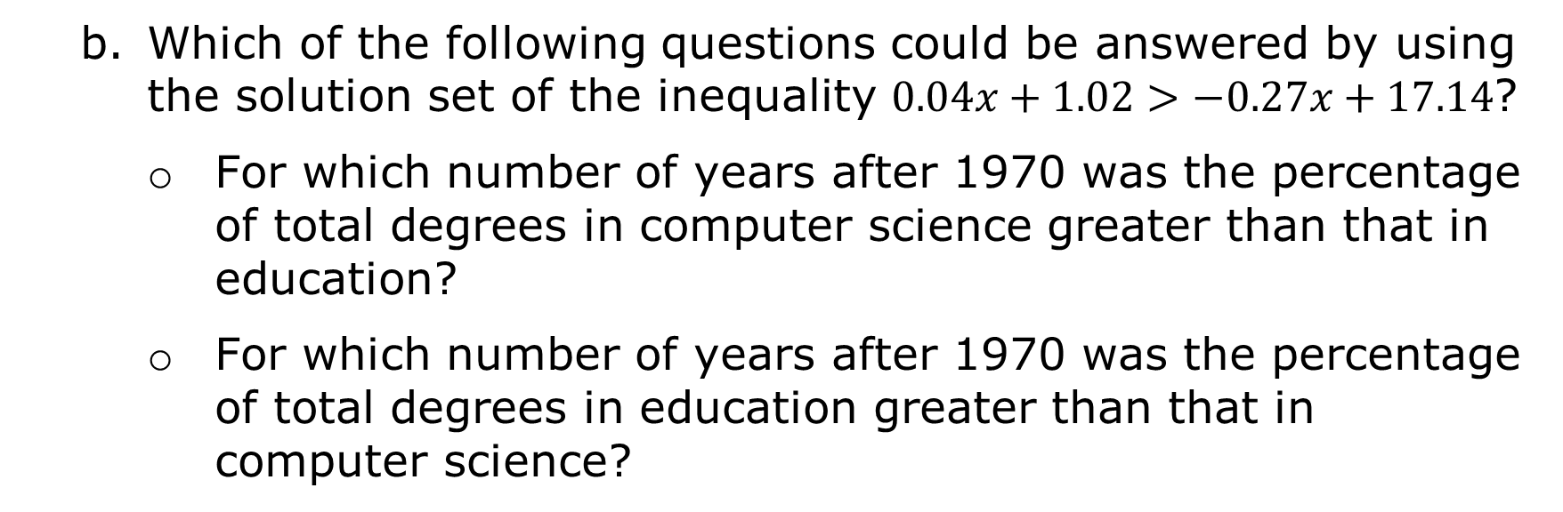
Which of the following questions could be answered by using the solution set of the inequality $0.04x+1.02>−0.27x+17.14$?
For which number of years after 1970 was the percentage of total degrees in computer science greater than that in education?
For which number of years after 1970 was the percentage of total degrees in education greater than that in computer science?
volume 1, pg. 294

Slide 21
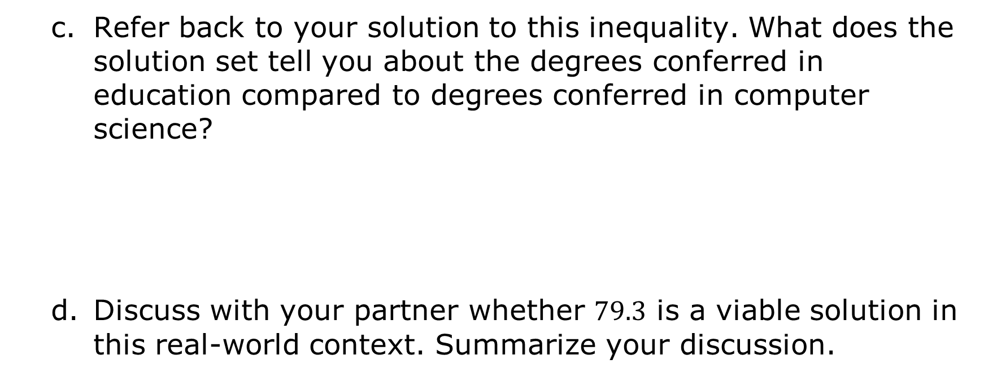
Refer back to your solution to this inequality. What does the solution set tell you about the degrees conferred in education compared to degrees conferred in computer science?
Discuss with your partner whether $79.3$ is a viable solution in this real-world context. Summarize your discussion.
volume 1, pg. 295

Slide 22

Collaboration
volume 1, pg. 295

Slide 23

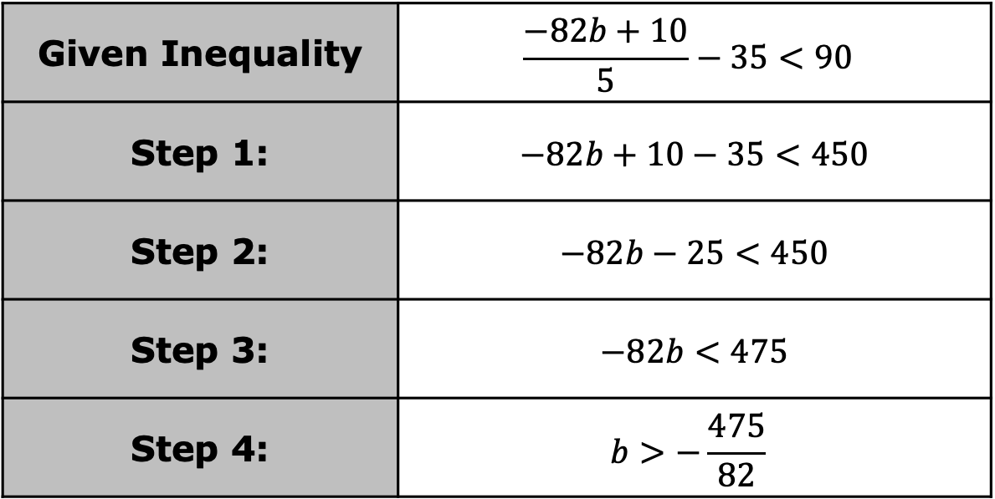
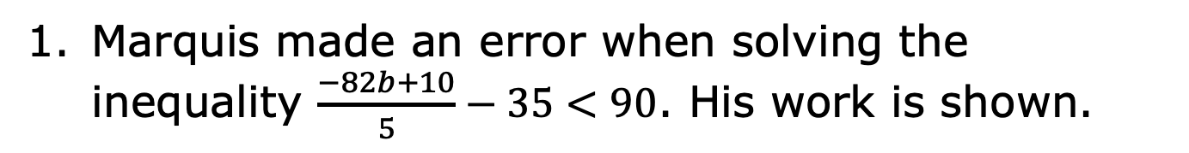
6.1.4 Collaboration: Multi-Step Inequalities in One Variable
Marquis made an error when solving the inequality $\frac{−82b+10}{5}−35<90$. His work is shown.
Given Inequality | $$\frac{−82b+10}{5}−35<90$$
Step 1: | $−82b+10−35<450$
Step 2: | $−82b−25<450$
Step 3: | $−82b<475$
Step 4: | $$b>−\frac{475}{82}$$
Volume 1, pg. 295

Slide 24
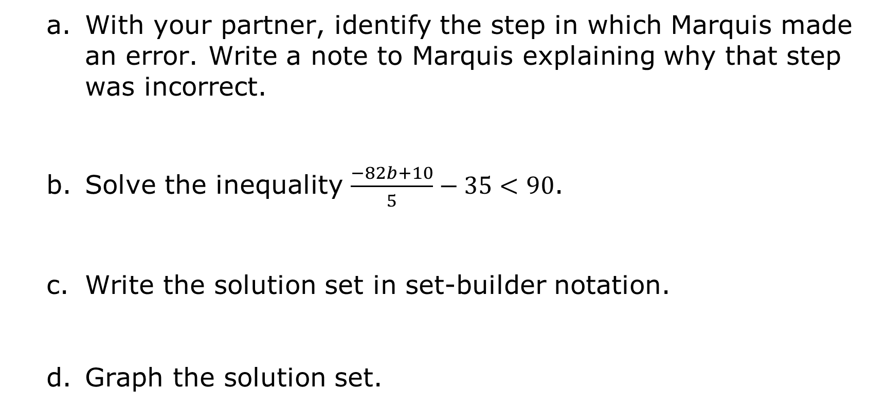
With your partner, identify the step in which Marquis made an error. Write a note to Marquis explaining why that step was incorrect.
Solve the inequality $\frac{−82b+10}{5}−35<90$.
Write the solution set in set-builder notation.
Graph the solution set.
volume 1, pg. 295

Slide 25
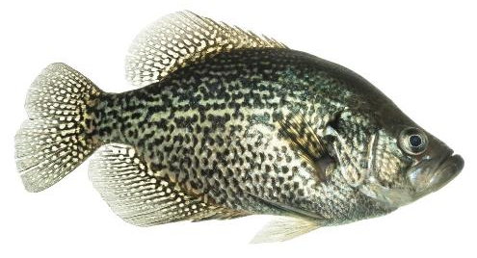
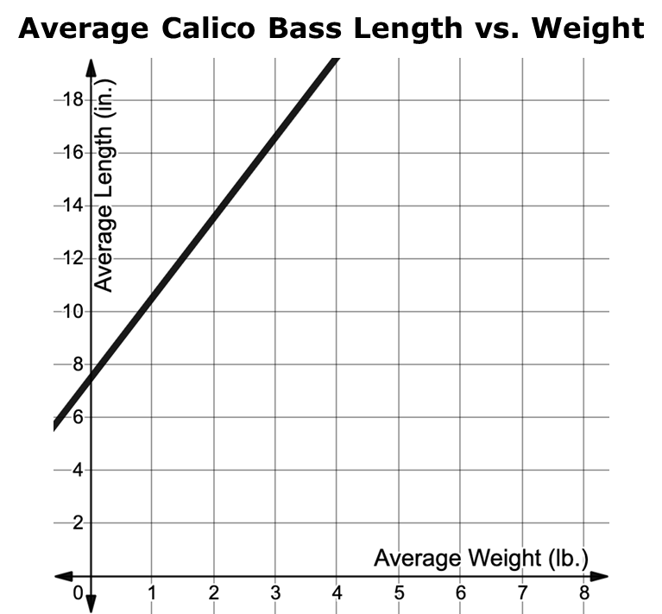
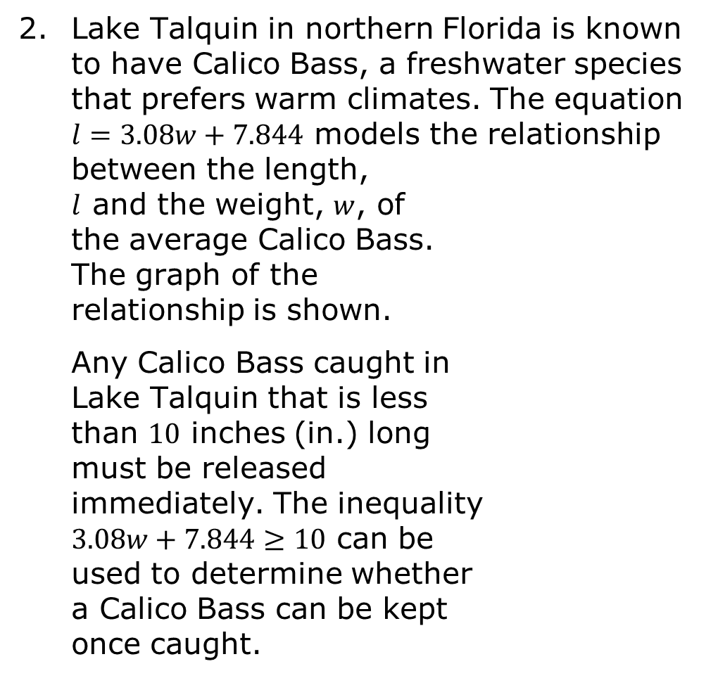
Lake Talquin in northern Florida is known to have Calico Bass, a freshwater species that prefers warm climates. The equation $l=3.08w+7.844$ models the relationship between the length, $l$ and the weight, $w$, of the average Calico Bass. The graph of the relationship is shown.
Any Calico Bass caught in Lake Talquin that is less than $10$ inches (in.) long must be released immediately. The inequality $3.08w+7.844≥10$ can be used to determine whether a Calico Bass can be kept once caught.
volume 1, pg. 296

Slide 26

Solve the inequality $3.08w+7.844≥10$.
Explain what the solution set represents in the context.
Graph the solution set.
volume 1, pg. 296

Slide 27
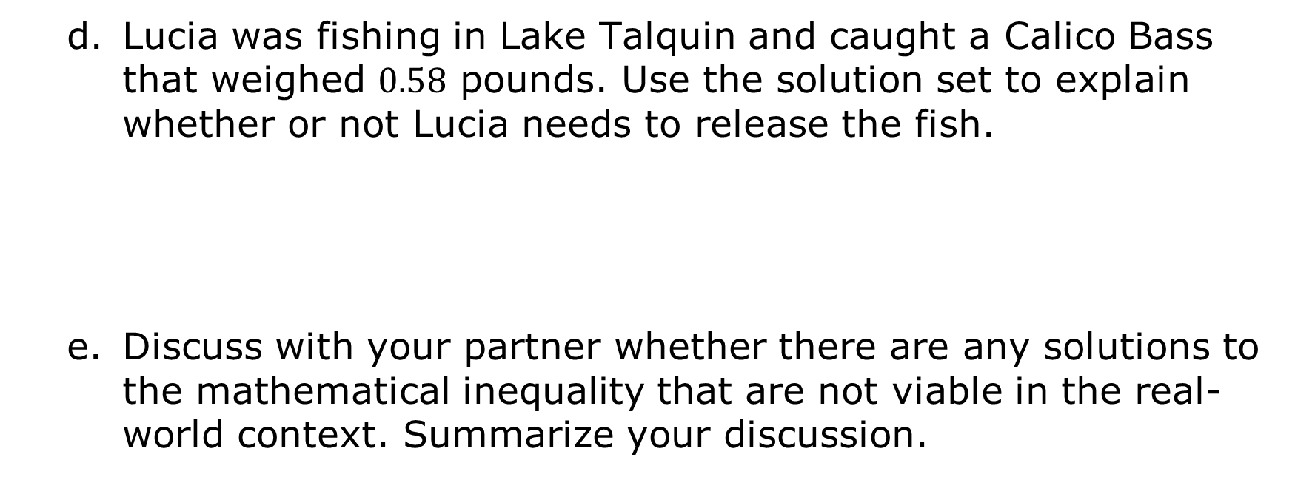
Lucia was fishing in Lake Talquin and caught a Calico Bass that weighed $0.58$ pounds. Use the solution set to explain whether or not Lucia needs to release the fish.
Discuss with your partner whether there are any solutions to the mathematical inequality that are not viable in the real-world context. Summarize your discussion.
volume 1, pg. 296

Slide 28

Wrap-Up
volume 1, pg. 297

Slide 29
6.1.5 Wrap-Up: Growth Mindset
“Many of life's failures are people who did not realize how close they were to success when they gave up.” - Thomas Edison
If you start to feel like quitting, what will you do in that moment to persevere?
What would you want your teacher to say to you when they see you taking a risk, trying hard, or pushing through mistakes to pursue this goal?
volume 1, pg. 297

